Slide 1
AI Smart Agriculture
DEPI · MICROSOFT MACHINE LEARNING · GROUP 3
Teaching a network to read farmland from space: tuning and testing on Sentinel-2 images
Milestone 3 · Model Optimization & Performance Tuning
Instructor: Mahmoud El-Sayed
Notes:
Milestone 2 ended with a 92% floor from frozen features. This milestone trains the network itself, tunes it, and opens the test set once.

Slide 2
From features to a trained, tuned model
MILESTONE 3 · WHAT THE BRIEF ASKS
01
02
03
Hyperparameter tuning
Model refinement
Test-set evaluation
Random Search over learning rate, batch size, dropout and weight decay.
BatchNorm, dropout, early stopping, removing or swapping layers.
Confusion matrix and accuracy for every land class, test set opened once.
92%
The floor to beat from Milestone 2: frozen ResNet-18 features with logistic regression (validation macro-F1).

Slide 3
99.2% of unseen satellite tiles are classified correctly
RESULT
99.23%
0.992
31
0.986
test accuracy, 4,050 images
test macro-F1 over 10 classes
mistakes, down from 59 for the baseline
5-fold cross-validation macro-F1, ± 0.0015
Notes:
All numbers are from the executed notebook. The test set was opened once, after every choice was final.

Slide 4
Same data, same split, strict rules
SETUP
Train 18,900
Val 4,050
Test 4,050
EuroSAT, as in Milestone 2
Validation makes every choice
Test is opened once
27,000 Sentinel-2 RGB tiles, 10 classes, identical stratified 70 / 15 / 15 split.
After all choices were final. Nothing changed after seeing it.
Hyperparameters, architecture and epochs are picked on validation only.

Slide 5
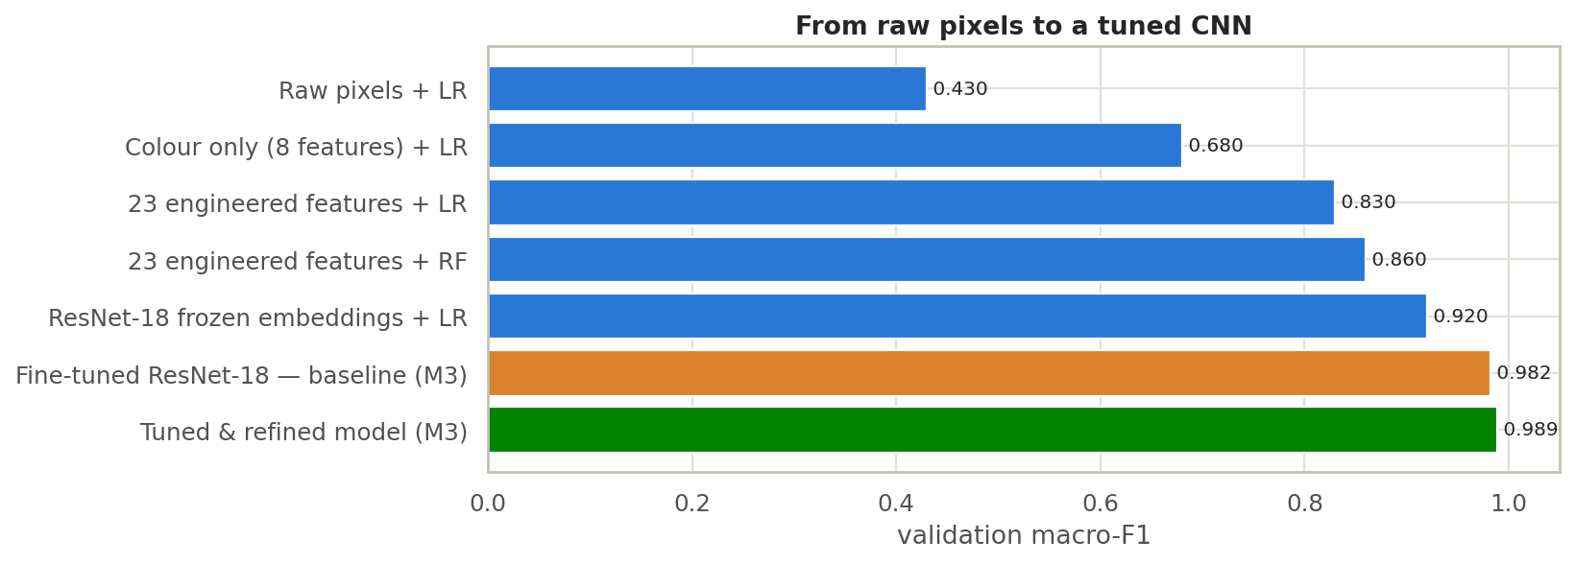
Fine-tuning alone lifts F1 from 0.92 to 0.98
BASELINE
0.920
frozen features (Milestone 2)
0.982
fine-tuned ResNet-18, default settings
0.989
after tuning and refinement
Notes:
Most of the gain over Milestone 2 comes from training the network itself. Tuning and refinement add about 0.7 points on top.

Slide 6
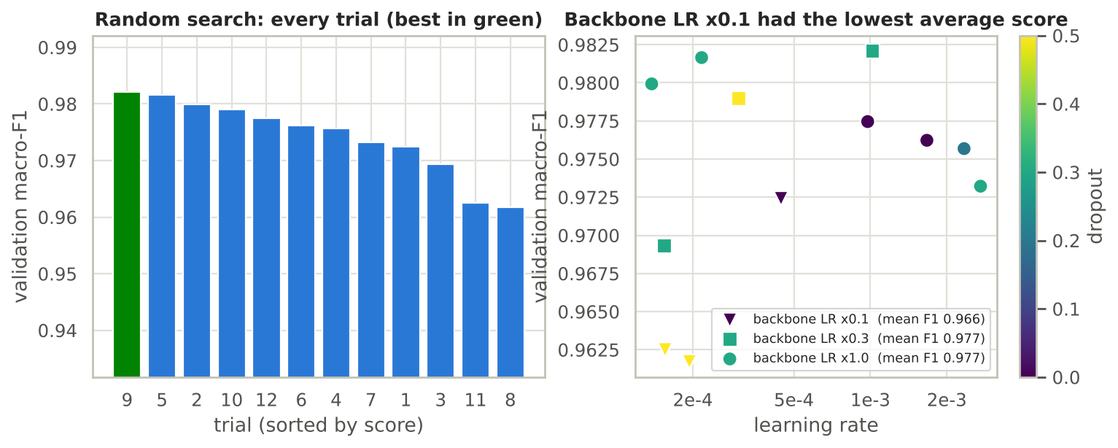
Random Search: a too-low backbone rate hurts most
HYPERPARAMETER TUNING
12 trials × 4 epochs. Scores ranged from 0.962 to 0.982; the top trials are effectively tied.
Backbone LR × 0.1 averaged 0.966, against 0.977 for × 0.3 and × 1.0. Other settings showed no clear effect.
Notes:
Twelve trials with one seed each give hints, not proof. The best trial was lr 1.0e-3, batch 32, dropout 0.3, weight decay 1.7e-3, backbone multiplier 0.3.

Slide 7
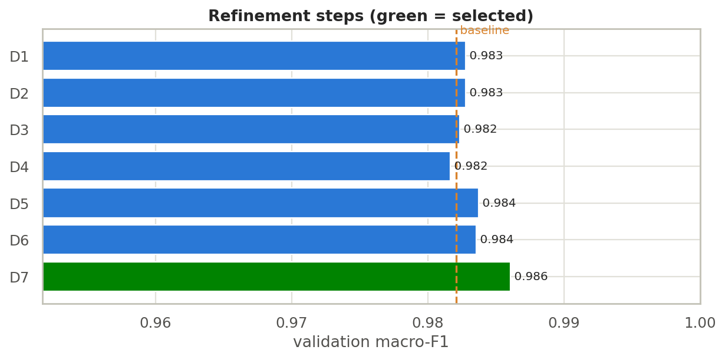
EfficientNet-B0 wins; a smaller ResNet nearly ties
MODEL REFINEMENT
D7 · EfficientNet-B0
Best validation F1 (0.9860) with 4.3 M parameters. Selected.
D6 · drop layer4
ResNet-18 shrinks from 11.2 M to 2.9 M parameters for 0.0002 F1.
One seed per step: gaps of 0.001–0.002 are within noise.

Slide 8
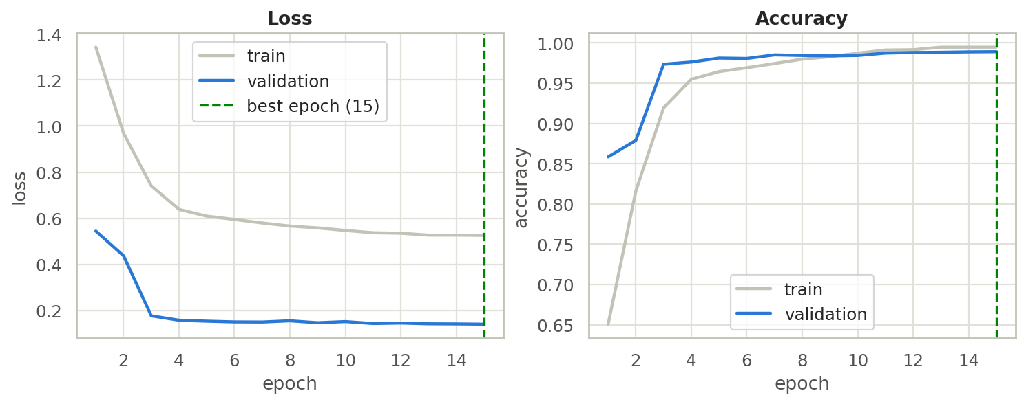
15 epochs, no sign of overfitting
FINAL TRAINING
Validation F1 0.9888 at epoch 15, still creeping up, so early stopping never fired.
Train 0.995 vs validation 0.989 accuracy: a small, healthy gap.
Train loss sits higher only because dropout and label smoothing apply in training alone.

Slide 9
Five folds, the same answer
CROSS-VALIDATION
Fold 1
Fold 2
Fold 3
Fold 4
Fold 5
0.9856
0.9885
0.9852
0.9853
0.9847
0.9858 ± 0.0015
macro-F1 across folds of train + validation. The result does not hinge on one lucky split.
Notes:
Each fold trained 6 epochs on 18,360 images and scored on 4,590. Slightly below the 15-epoch validation score because of the shorter run. The test set was not used.

Slide 10
The tuned model almost halves the errors
UNSEEN TEST SET · 4,050 IMAGES
Model | Accuracy | Macro-F1 | Mistakes
Baseline fine-tuned ResNet-18 | 0.9854 | 0.9847 | 59
Tuned and refined EfficientNet-B0 | 0.9923 | 0.9921 | 31
Same model + test-time augmentation | 0.9926 | 0.9924 | 30
95% confidence interval for the final accuracy: 98.94% to 99.48%. The baseline falls below it.
Test-time augmentation changes one image, so it is not our headline number.

Slide 11
Every land class scores above 98%
TEST SET · EVERY CLASS
Class | Recall | F1
AnnualCrop | 0.984 | 0.987
Forest | 0.993 | 0.997
HerbaceousVegetation | 0.993 | 0.988
Highway | 0.995 | 0.995
Industrial | 0.995 | 0.992
Class | Recall | F1
Pasture | 0.983 | 0.985
PermanentCrop | 0.987 | 0.987
Residential | 0.993 | 0.997
River | 1.000 | 0.999
SeaLake | 0.998 | 0.997
Agriculture
Water
Urban
Roads
Trees
0.987
0.999
0.994
0.995
0.993
Notes:
Orange marks the two weakest classes. The five dark cards are the brief's categories (exact-class accuracy): agriculture groups AnnualCrop, PermanentCrop, Pasture and HerbaceousVegetation; urban groups Residential and Industrial. EuroSAT has no desert class.

Slide 12
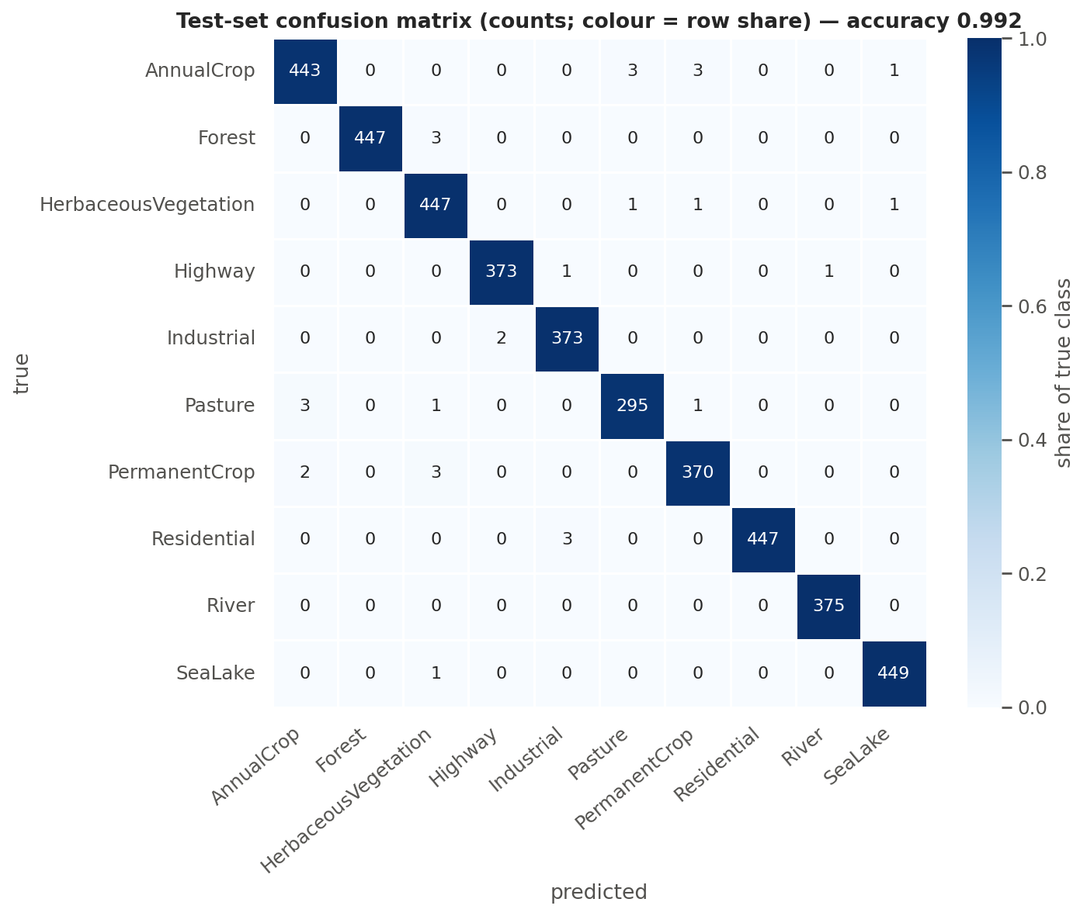
Mistakes stay inside the farmland family
WHERE THE ERRORS ARE
20 of 31
mistakes are between farmland classes, mostly 2–3 images each.
2 of 1,575
farmland tiles were labelled as non-farmland.
1 of 375
Highway tiles taken for River. Milestone 2 measured 7–14% on validation.

Slide 13
What 99.2% does not tell us
HONEST LIMITS
Same-distribution test
Small gaps are noise
EuroSAT tiles are European RGB images. We have not tested Egyptian farmland yet.
One seed per experiment. Differences of 0.001–0.002 F1 between refinements cannot be ranked.
Still improving at epoch 15
RGB only, no near-infrared
Training stopped by budget, not by early stopping. A longer run may add a little.
The NDVI idea from Milestone 2 was not used. Some remaining errors look ambiguous even to the eye.

Slide 14
A tuned model, ready for deployment
WHAT WE HAND IN · WHAT COMES NEXT
Optimized model
Evaluation report
EfficientNet-B0, 4.3 M parameters, saved weights and a config with image size, normalization and class order.
Test metrics, per-class accuracy, confusion matrix, error analysis and limits, plus the executed notebook.
Milestone 4: deploy and visualize
Serve the model with Flask or FastAPI and an upload page, show classified land on a dashboard, and first check it on Sentinel-2 tiles from Egypt.

Slide 15
Thank you
AI SMART AGRICULTURE · GROUP 3
Questions & discussion
Amar Mohamed · Ahmed Aymen · Pierre Hany · Serag Omar · Amr Ahmed · Yousef Medhat · Yousef Yassin

